Slide 1

CSE 425: Computer Graphics
Dr. B. J. Ferdosi

Slide 2

Shown in SIGGRAPH1986
SIGGRAPH (Special Interest Group on Computer GRAPHics and Interactive Techniques) is the annual conference on computer graphics (CG) convened by the ACM SIGGRAPHorganization.

Slide 4
Text Books
Interactive Computer Graphics: A Top-Down Approach Using OpenGL,
by E. Angel and Dave Shreiner
Fundamentals of Computer Graphics
by Peter Shirley et al.,
3. Computer Graphics principles and practices
by Foley et al.
4. Schaum's Outline of Computer Graphics
by Zhigang Xiang and Roy A. Plastock
5. OpenGL Red Book
http://www.glprogramming.com/red/
LIBRARY : GOOGLE !

Slide 5

Grading
Assessment: 30
Mid Term : 20
Final: 50
Assessment:
After the class small quizzes/Viva: 10
Class tests : 10
Assignment: 10
Requirement of attending the Final Exam: 60 % attendance

Slide 6


Cheating – Zero Tolerance
Please don’t cheat!
(I trust you. Don’t break my trust!)

Slide 7

Goals of Computer Graphics
Faking reality – convincingly.
Creating alternative reality.

Slide 8
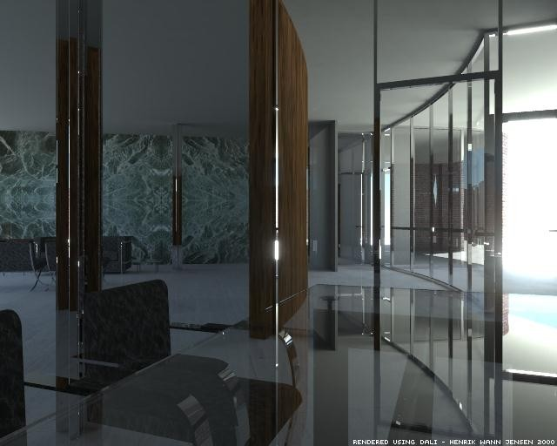
Faking Reality

Slide 9
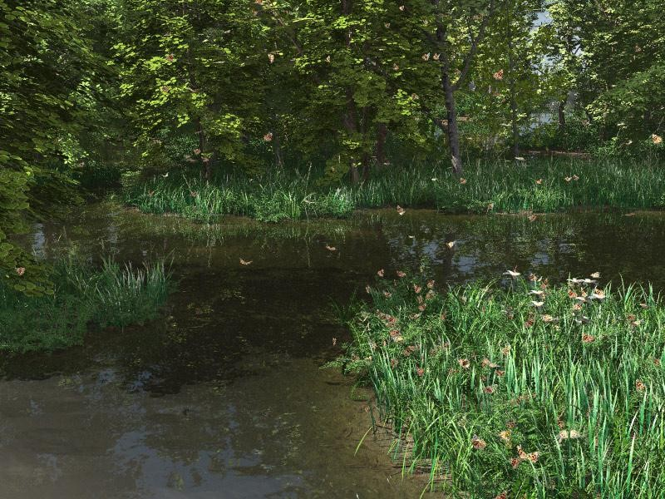
Faking Reality

Slide 10
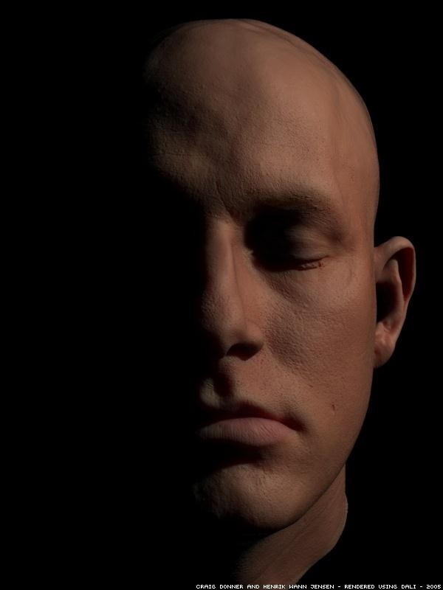
Faking Reality

Slide 11

Alternative reality

Slide 12
What are the applications of graphics?
Movies / Special Effects Video Games
Simulation CAD-CAM & Design
Architecture Virtual Reality
Visualization Medical Imaging
Education Geographic Info Systems & GPS
User Interface
Any display and much more....

Slide 13
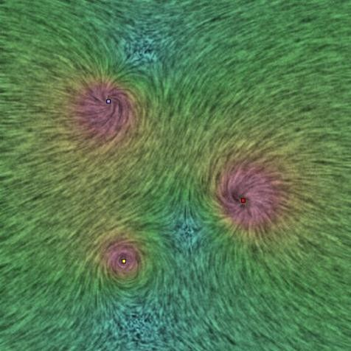
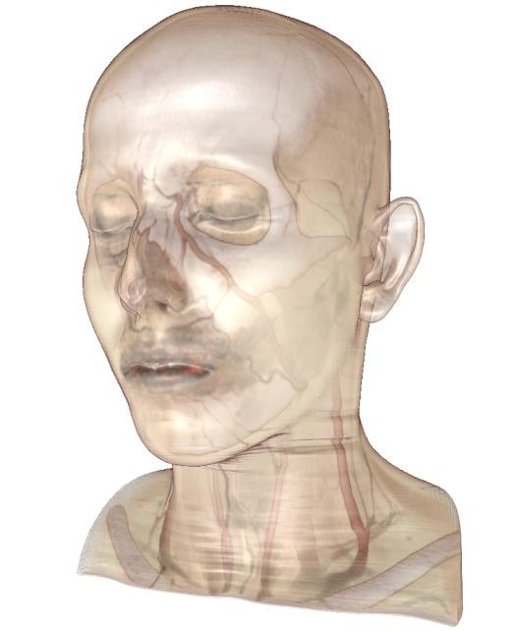
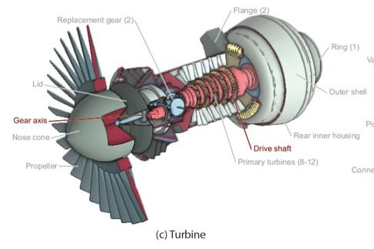



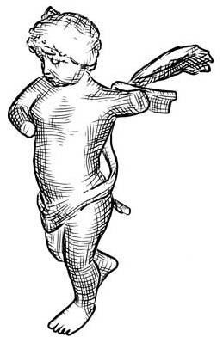

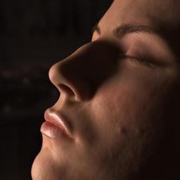



What else use Computer Graphics
Scientific Visualization
Illustration
NPR / Art
Computational Photography
and much more....
Virtual Life

Slide 14
Fundamental to a lot of fields

Slide 15
What do you expect to learn?
And Why?

Slide 16
What you will learn in CSE 425
Fundamentals of computer graphics algorithms
We will concentrate on 3D, not 2D illustration or image processing
Basics of real-time rendering and graphics hardware
Basic OpenGL
–Not the focus, though: Means, not the end.

Slide 17
What you will NOT learn in CSE 425
OpenGL and DirectX hacks
Software packages
CAD-CAM, 3D Studio MAX, Maya
Photoshop and other painting tools
Artistic skills
Game design

Slide 18
A Brief History
• Father of the Field – Ivan Sutherland, 1963

Slide 19
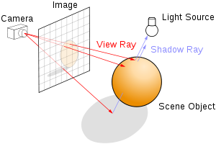
Ray Tracing (1980)
In computer graphics, ray tracing is a rendering technique for generating an image by tracing the path of light as pixels in an image plane and simulating the effects of its encounters with virtual objects.

Slide 20
Silicon Graphics – First GPU -- 1983
Introduced the graphics pipeline
Essentially a 4x4 matrix engine
Software library -- gl

Slide 21
OpenGL -- 1994
Open Software Library for Graphics

Slide 22
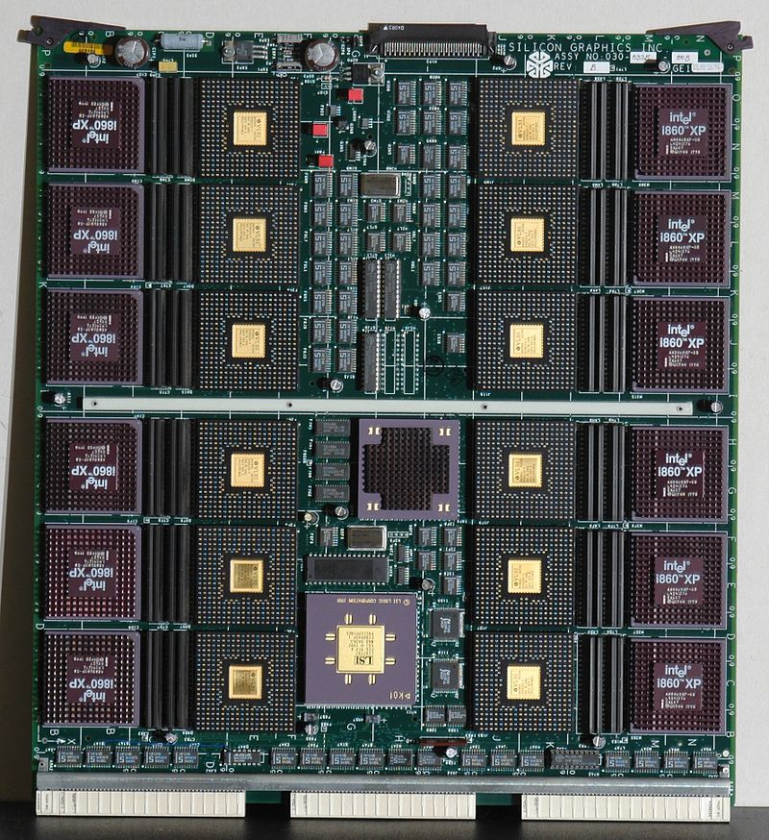
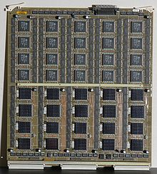
Reality Engine -- 1994
Geometry Engine board.
Raster Manager board

Slide 23
Now -- GPU Everywhere
Programmable GPUs to complement CPUs

Slide 26
Haptic or kinesthetic communication recreates the sense of touch by applying forces, vibrations, or motions to the user.This mechanical stimulation can be used to assist in the creation of virtual objects in a computer simulation, to control such virtual objects, and to enhance the remote control of machines and devices (telerobotics). Haptic devices may incorporate tactile sensors that measure forces exerted by the user on the interface.

Slide 31
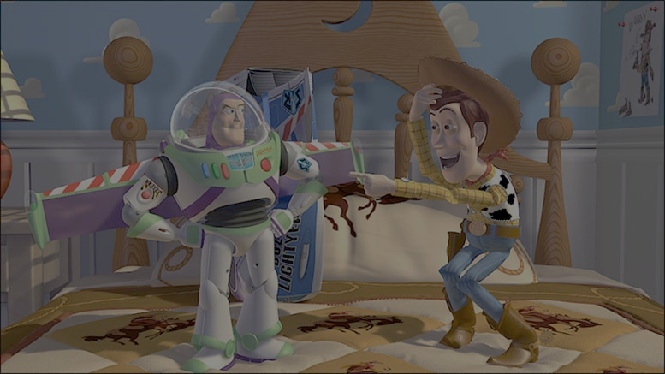
How do you make this picture?
Modeling
–Geometry
–Materials
–Lights
•Animation
–Make it move
•Rendering
–i.e., draw the picture!
–Lighting, shadows, textures...
We need
–Mathematics
–Physics
–Computer Science

Slide 32

image containing 19 billion (19 000 000 000) triangles.

Slide 33
Syllabus and Schedule

